Slide 1
Chapter 15
GAME THEORY MODELS
OF PRICING
Copyright ©2005 by South-Western, a division of Thomson Learning. All rights reserved.

Slide 2
Game Theory
Game theory involves the study of strategic situations
Game theory models attempt to portray complex strategic situations in a highly simplified and stylized setting
  abstract from personal and institutional details in order to arrive at a representation of the situation that is mathematically tractable

Slide 3
Game Theory
All games have three elements
  players
  strategies
  payoffs
Games may be cooperative or noncooperative

Slide 4
Players
Each decision-maker in a game is called a player
  can be an individual, a firm, an entire nation
Each player has the ability to choose among a set of possible actions
The specific identity of the players is irrelevant
  no “good guys” or “bad guys”

Slide 5
Strategies
Each course of action open to a player is called a strategy
Strategies can be very simple or very complex
  each is assumed to be well-defined
In noncooperative games, players are uncertain about the strategies used by other players

Slide 6
Payoffs
The final returns to the players at the end of the game are called payoffs
Payoffs are usually measured in terms of utility
  monetary payoffs are also used
It is assumed that players can rank the payoffs associated with a game

Slide 7
Notation
We will denote a game G between two players (A and B) by
G[S_{A},S_{B},U_{A}(a,b),U_{B}(a,b)]
where
    S_{A} = strategies available for player A (a ⊂ S_{A})
    S_{B} = strategies available for player B (b ⊂ S_{B})
    U_{A} = utility obtained by player A when particular strategies are chosen
    U_{B} = utility obtained by player B when particular strategies are chosen

Slide 8
Nash Equilibrium in Games
At market equilibrium, no participant has an incentive to change his behavior
In games, a pair of strategies (a*,b*) is defined to be a Nash equilibrium if a* is player A’s best strategy when player B plays b*, and b* is player B’s best strategy when player A plays a*

Slide 9
Nash Equilibrium in Games
A pair of strategies (a*,b*) is defined to be a Nash equilibrium if
U_{A}(a*,b*) ≥ U_{A}(a’,b*) for all a’⊂S_{A}
U_{B}(a*,b*) ≥ U_{b}(a*,b’) for all b’⊂S_{B}

Slide 10
Nash Equilibrium in Games
If one of the players reveals the equilibrium strategy he will use, the other player cannot benefit
  this is not the case with nonequilibrium strategies
Not every game has a Nash equilibrium pair of strategies
Some games may have multiple equilibria

Slide 11
A Dormitory Game
Suppose that there are two students who must decide how loudly to play their stereos in a dorm
  each may choose to play it loudly (L) or softly (S)

Slide 12
A Dormitory Game
A chooses loud (L) or soft (S)
B makes a similar
choice
7,5
L
Neither player
knows the other’s
strategy
B
L
S
5,4
A
L
6,4
Payoffs are in
terms of A’s utility
level and B’s
utility level
S
B
S
6,3

Slide 13
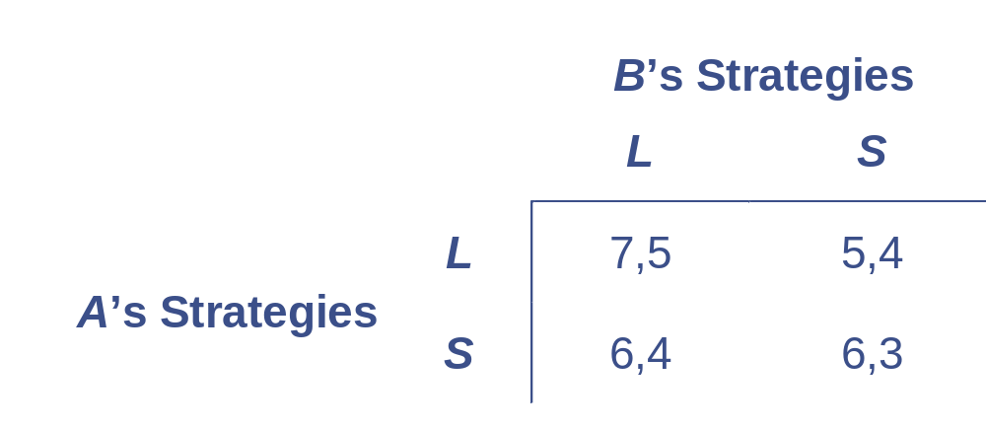
A Dormitory Game
Sometimes it is more convenient to describe games in tabular (“normal”) form

Slide 14
A Dormitory Game
A loud-play strategy is a dominant strategy for player B
  the L strategy provides greater utility to B than does the S strategy no matter what strategy A chooses
Player A will recognize that B has such a dominant strategy
  A will choose the strategy that does the best against B’s choice of L

Slide 15
A Dormitory Game
This means that A will also choose to play music loudly
The A:L,B:L strategy choice obeys the criterion for a Nash equilibrium
    because L is a dominant strategy for B, it is the best choice no matter what A does
    if A knows that B will follow his best strategy, then L is the best choice for A

Slide 16
Existence of Nash Equilibria
A Nash equilibrium is not always present in two-person games
This means that one must explore the details of each game situation to determine whether such an equilibrium (or multiple equilibria) exists

Slide 17
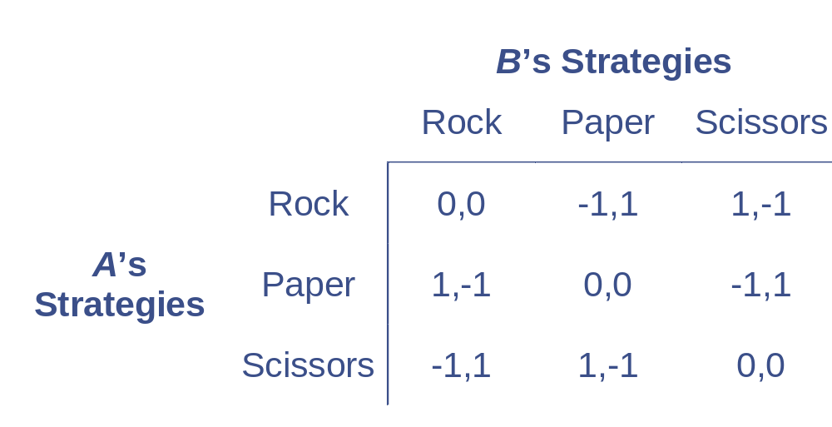
No Nash Equilibria
Any strategy is unstable because it offers the other players an incentive to adopt another strategy

Slide 18
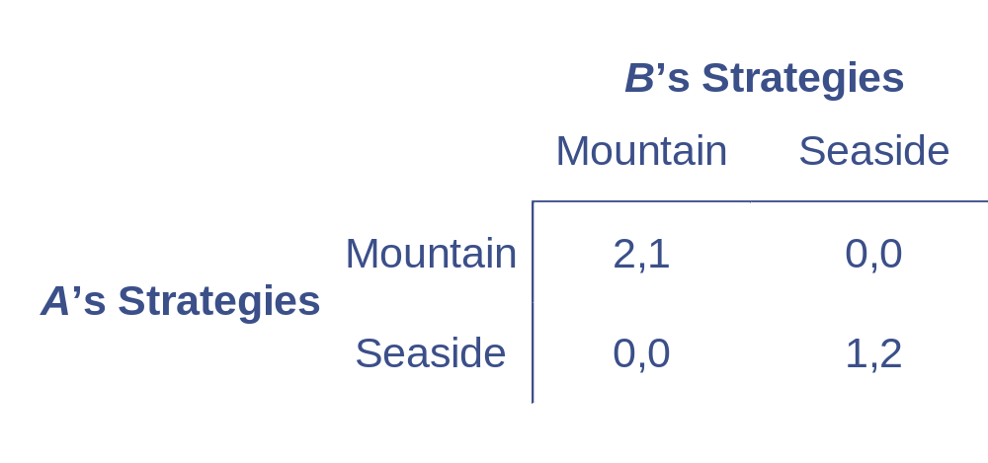
Two Nash Equilibria
Both of the joint vacations represent Nash equilibria

Slide 19
Existence of Nash Equilibria
There are certain types of two-person games in which a Nash equilibrium must exist
  games in which the participants have a large number of strategies
    games in which the strategies chosen by A and B are alternate levels of a single continuous variable
    games where players use mixed strategies

Slide 20
Existence of Nash Equilibria
In a game where players are permitted to use mixed strategies, each player may play the pure strategies with certain, pre-selected probabilities
  player A may flip a coin to determine whether to play music loudly or softly
  the possibility of playing the pure strategies with any probabilities a player may choose, converts the game into one with an infinite number of mixed strategies

Slide 21
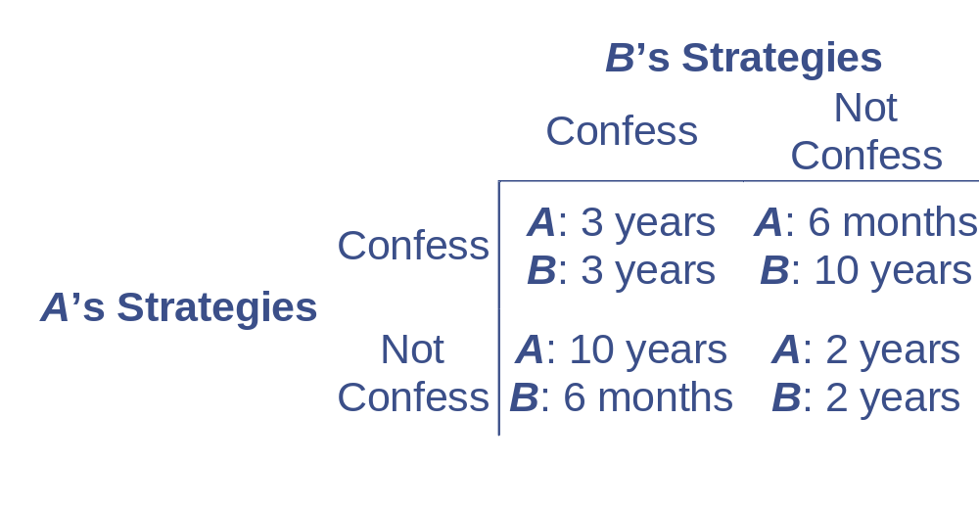
The Prisoners’ Dilemma
The most famous two-person game with an undesirable Nash equilibrium outcome

Slide 22
The Prisoners’ Dilemma
An ironclad agreement by both prisoners not to confess will give them the lowest amount of joint jail time
  this solution is not stable
The “confess” strategy dominates for both A and B
  these strategies constitute a Nash equilibrium

Slide 23
The Tragedy of the Common
This example is used to signify the environmental problems of overuse that occur when scarce resources are treated as “common property”
Assume that two herders are deciding how many of their yaks they should let graze on the village common
  problem: the common is small and can rapidly become overgrazed

Slide 24
The Tragedy of the Common
Suppose that the per yak value of grazing on the common is
V(Y_{A},Y_{B})=120 – (Y_{A} + Y_{B})
where Y_{A} and Y_{B} = number of yaks of each herder
Note that both V_{i} < 0 and V_{ii} < 0
  an extra yak reduces V and this marginal effect increases with additional grazing

Slide 25
The Tragedy of the Common
Solving herder A’s value maximization problem:
Max Y_{A}V = Max [120Y_{A} – Y_{A}(Y_{A} + Y_{B})]
The first-order condition is
= 120 – 2Y_{A} – Y_{B} = 0
Y_{A} =60- Y_{B} /2 =BR(Y_{B})
Similarly, for B the optimal strategy is
= 120 – 2Y_{B} – Y_{A} = 0
Y_{B} =60- Y_{A} /2 =BR(Y_{A})

Slide 26
The Tragedy of the Common
For a Nash equilibrium, the values for Y_{A} and Y_{B} must solve both of these conditions
Simultaneously solving the two equation, Each herder will obtain Y_{A} = Y_{B} = 40 and payoff=1600
Given this choice, neither herder has an incentive to change his behavior

Slide 27
The Tragedy of the Common
The Nash equilibrium is not the best use of the common
Y_{A} = Y_{B} = 30 provides greater return to each herder = But Y_{A} + Y_{B} = 60 is not a stable equilibrium and total payoff=1800
  if A announces that Y_{A} = 30, B will have an incentive to increase Y_{B}
  there is an incentive to cheat

Slide 28
Cooperation and Repetition
Cooperation among players can result in outcomes that are preferred to the Nash outcome by both players
  the cooperative outcome is unstable because it is not a Nash equilibrium
Repeated play may foster cooperation

Slide 29
A Two-Period Dormitory Game
Let’s assume that A chooses his decibel level first and then B makes his choice
In effect, that means that the game has become a two-period game
  B’s strategic choices must take into account the information available at the start of period two

Slide 30
A Two-Period Dormitory Game
A chooses loud (L) or soft (S)
7,5
B makes a similar
choice knowing
A’s choice
L
B
L
S
5,4
A
Thus, we should
put B’s strategies
in a form that takes
the information on
A’s choice into
account
L
6,4
S
B
S
6,3

Slide 31
A Two-Period Dormitory Game
Each strategy is stated as a pair of actions showing what B will do depending on A’s actions
 |  | B’s Strategies
 |  | L,L | L,S | S,L | S,S
A’s Strategies | L | 7,5 | 7,5 | 5,4 | 5,4
 | S | 6,4 | 6,3 | 6,4 | 6,3

Slide 32
A Two-Period Dormitory Game
There are 3 Nash equilibria in this game
  A:L, B:(L,L)
  A:L, B:(L,S)
  A:S, B:(S,L)
 |  | B’s Strategies
 |  | L,L | L,S | S,L | S,S
A’s Strategies | L | 7,5 | 7,5 | 5,4 | 5,4
 | S | 6,4 | 6,3 | 6,4 | 6,3

Slide 33
A Two-Period Dormitory Game
A:L, B:(L,S) and A:S, B:(S,L) are implausible
  each incorporates a noncredible threat on the part of B
 |  | B’s Strategies
 |  | L,L | L,S | S,L | S,S
A’s Strategies | L | 7,5 | 7,5 | 5,4 | 5,4
 | S | 6,4 | 6,3 | 6,4 | 6,3

Slide 34
A Two-Period Dormitory Game
Thus, the game is reduced to the original payoff matrix where (L,L) is a dominant strategy for B
  A will recognize this and will always choose L
This is a subgame perfect equilibrium
  a Nash equilibrium in which the strategy choices of each player do not involve noncredible threats

Slide 35
Subgame Perfect Equilibrium
A “subgame” is the portion of a larger game that begins at one decision node and includes all future actions stemming from that node
To qualify to be a subgame perfect equilibrium, a strategy must be a Nash equilibrium in each subgame of a larger game

Slide 36
Repeated Games
Many economic situations can be modeled as games that are played repeatedly
  consumers’ regular purchases from a particular retailer
  firms’ day-to-day competition for customers
  workers’ attempts to outwit their supervisors

Slide 37
Repeated Games
An important aspect of a repeated game is the expanded strategy sets that become available to the players
  opens the way for credible threats and subgame perfection

Slide 38
Repeated Games
The number of repetitions is also important
  in games with a fixed, finite number of repetitions, there is little room for the development of innovative strategies
  games that are played an infinite number of times offer a much wider array of options

Slide 39
Prisoners’ Dilemma Finite Game
If the game was played only once, the Nash equilibrium A:C, B:C would be the expected outcome
 |  | B’s Strategies
 |  | C | D
A’s Strategies | C | 1,1 | 3,0
 | D | 0,3 | 2,2

Slide 40
Prisoners’ Dilemma Finite Game
This outcome is inferior to A:D, B:D for each player
 |  | B’s Strategies
 |  | C | D
A’s Strategies | C | 1,1 | 3,0
 | D | 0,3 | 2,2

Slide 41
Prisoners’ Dilemma Finite Game
Suppose this game is to be repeatedly played for a finite number of periods (T)
Any expanded strategy in which A promises to play D in the final period is not credible
  when T arrives, A will choose strategy C
The same logic applies to player B

Slide 42
Prisoners’ Dilemma Finite Game
Any subgame perfect equilibrium for this game can only consist of the Nash equilibrium strategies in the final round
  A:C,B:C
The logic that applies to period T also applies to period T-1
The only subgame perfect equilibrium in this finite game is to require the Nash equilibrium in every round

Slide 43
Game with Infinite Repetitions
In this case, each player can announce a “trigger strategy”
  promise to play the cooperative strategy as long as the other player does
  when one player deviates from the pattern, the game reverts to the repeating single-period Nash equilibrium

Slide 44
Game with Infinite Repetitions
Whether the twin trigger strategy represents a subgame perfect equilibrium depends on whether the promise to play cooperatively is credible
Suppose that A announces that he will continue to play the trigger strategy by playing cooperatively in period K

Slide 45
Game with Infinite Repetitions
If B decides to play cooperatively, payoffs of 2 can be expected to continue indefinitely
If B decides to cheat, the payoff in period K will be 3, but will fall to 1 in all future periods
  the Nash equilibrium will reassert itself

Slide 46
Game with Infinite Repetitions
If δ is player B’s discount rate, the present value of continued cooperation is
2 + δ2 + δ²2 + … = 2/(1-δ)
The payoff from cheating is
3 + δ1 + δ²1 + …= 3 + 1/(1-δ)
Continued cooperation will be credible if
2/(1-δ) > 3 + 1/(1-δ)
δ > ½

Slide 47
The Tragedy of the Common Revisited
The overgrazing of yaks on the village common may not persist in an infinitely repeated game
Assume that each herder has only two strategies available
  bringing 4 or 5 yaks to the common
The Nash equilibrium (A:5,B:5) is inferior to the cooperative outcome (A:4,B:4)

Slide 48
The Tragedy of the Common Revisited
With an infinite number of repetitions, both players would find it attractive to adopt cooperative trigger strategies if
544/(1-δ) > 595 + 500(1-δ)
δ > 551/595 = 0.93

Slide 49
Pricing in Static Games
Suppose there are only two firms (A and B) producing the same good at a constant marginal cost (c)
  the strategies for each firm consist of choosing prices (P_{A} and P_{B}) subject only to the condition that the firm’s price must exceed c
Payoffs in the game will be determined by demand conditions

Slide 50
Pricing in Static Games
Because output is homogeneous and marginal costs are constant, the firm with the lower price will gain the entire market
If P_{A} = P_{B}, we will assume that the firms will share the market equally

Slide 51
Pricing in Static Games
In this model, the only Nash equilibrium is P_{A} = P_{B} = c
  if firm A chooses a price greater than c, the profit-maximizing response for firm B is to choose a price slightly lower than P_{A} and corner the entire market
  but B’s price (if it exceeds c) cannot be a Nash equilibrium because it provides firm A with incentive for further price cutting

Slide 52
Pricing in Static Games
Therefore, only by choosing P_{A} = P_{B} = c will the two firms have achieved a Nash equilibrium
  we end up with a competitive solution even though there are only two firms
This pricing strategy is sometimes referred to as a Bertrand equilibrium

Slide 53
Pricing in Static Games
The Bertrand result depends crucially on the assumptions underlying the model
  if firms do not have equal costs or if the goods produced by the two firms are not perfect substitutes, the competitive result no longer holds

Slide 54
Pricing in Static Games
Other duopoly models that depart from the Bertrand result treat price competition as only the final stage of a two-stage game in which the first stage involves various types of entry or investment considerations for the firms

Slide 55
Pricing in Static Games
Consider the case of two owners of natural springs who are deciding how much water to supply
Assume that each firm must choose a certain capacity output level
  marginal costs are constant up to that level and infinite thereafter

Slide 56
Pricing in Static Games
A two-stage game where firms choose capacity first (and then price) is formally identical to the Cournot analysis
  the quantities chosen in the Cournot equilibrium represent a Nash equilibrium
    each firm correctly perceives what the other’s output will be
  once the capacity decisions are made, the only price that can prevail is that for which quantity demanded is equal to total capacity

Slide 57
Pricing in Static Games
Suppose that capacities are given by q_{A}’ and q_{B}’ and that
P’ = D ⁻¹(q_{A}’ + q_{B}’)
where D ⁻¹ is the inverse demand function
A situation in which P_{A} = P_{B} < P’ is not a Nash equilibrium
  total quantity demanded > total capacity so one firm could increase its profits by raising its price and still sell its capacity

Slide 58
Pricing in Static Games
Likewise, a situation in which P_{A} = P_{B} > P’ is not a Nash equilibrium
  total quantity demanded < total capacity so at least one firm is selling less than its capacity
    by cutting price, this firm could increase its profits by taking all possible sales up to its capacity
    the other firm would end up lowering its price as well

Slide 59
Pricing in Static Games
The only Nash equilibrium that will prevail is P_{A} = P_{B} = P’
  this price will fall short of the monopoly price but will exceed marginal cost
The results of this two-stage game are indistinguishable from the Cournot model

Slide 60
Pricing in Static Games
The Bertrand model predicts competitive outcomes in a duopoly situation
The Cournot model predicts monopoly-like inefficiencies
This suggests that actual behavior in duopoly markets may exhibit a wide variety of outcomes depending on the way in which competition occurs

Slide 61
Repeated Games and Tacit Collusion
Players in infinitely repeated games may be able to adopt subgame-perfect Nash equilibrium strategies that yield better outcomes than simply repeating a less favorable Nash equilibrium indefinitely
  do the firms in a duopoly have to endure the Bertrand equilibrium forever?
  can they achieve more profitable outcomes through tacit collusion?

Slide 62
Repeated Games and Tacit Collusion
With any finite number of replications, the Bertrand result will remain unchanged
  any strategy in which firm A chooses P_{A} > c in period T (the final period) offers B the option of choosing P_{A} > P_{B} > c
    A’s threat to charge P_{A} in period T is noncredible
  a similar argument applies to any period prior to T

Slide 63
Repeated Games and Tacit Collusion
If the pricing game is repeated over infinitely many periods, twin “trigger” strategies become feasible
  each firm sets its price equal to the monopoly price (P_{M}) providing the other firm did the same in the prior period
  if the other firm “cheated” in the prior period, the firm will opt for competitive pricing in all future periods

Slide 64
Repeated Games and Tacit Collusion
Suppose that, after the pricing game has been proceeding for several periods, firm B is considering cheating
  by choosing P_{B} < P_{A} = P_{M} it can obtain almost all of the single period monopoly profits (π_{M})

Slide 65
Repeated Games and Tacit Collusion
If firm B continues to collude tacitly with A, it will earn its share of the profit stream
(π_{M} + δπ_{M} + δ²π_{M} +…+ δ^{n}π_{M} +…)/2
= (π_{M} /2)[1/(1- δ)]
where δ is the discount factor applied to future profits

Slide 66
Repeated Games and Tacit Collusion
Cheating will be unprofitable if
π_{M} < (π_{M} /2)[1/(1- δ)]
or if
δ > 1/2
Providing that firms are not too impatient, the trigger strategies represent a subgame perfect Nash equilibrium of tacit collusion

Slide 67
Tacit Collusion
Suppose only two firms produce steel bars for jailhouse windows
Bars are produced at a constant AC and MC of $10 and the demand for bars is
Q = 5,000 - 100P
Under Bertrand competition, each firm will charge a price of $10 and a total of 4,000 bars will be sold

Slide 68
Tacit Collusion
The monopoly price in this market is $30
  each firm has an incentive to collude
  total monopoly profits will be $40,000 each period (each firm will receive $20,000)
  any one firm will consider a next-period price cut only if $40,000 > $20,000 (1/1-δ)
    δ will have to be fairly high for this to occur

Slide 69
Tacit Collusion
The viability of a trigger price strategy may depend on the number of firms
  suppose there are 8 producers
  total monopoly profits will be $40,000 each period (each firm will receive $5,000)
  any one firm will consider a next-period price cut if $40,000 > $5,000 (1/1-δ)
    this is likely at reasonable levels of δ

Slide 70
Generalizations and Limitations
The viability of tacit collusion in game theory models is very sensitive to the assumptions made
We assumed that:
  firm B can easily detect that firm A has cheated
  firm B responds to cheating by adopting a harsh response that not only punishes A, but also condemns B to zero profits forever

Slide 71
Generalizations and Limitations
In more general models of tacit collusion, these assumptions can be relaxed
  difficulty in monitoring other firm’s behavior
  other forms of punishment
  differentiated products

Slide 72
Entry, Exit, and Strategy
In previous models, we have assumed that entry and exit are driven by the relationship between the prevailing market price and a firm’s average cost
The entry and exit issue can become considerably more complex

Slide 73
Entry, Exit, and Strategy
A firm wishing to enter or exit a market must make some conjecture about how its actions will affect the future market price
  this requires the firm to consider what its rivals will do
  this may involve a number of strategic ploys
    especially when a firm’s information about its rivals is imperfect

Slide 74
Sunk Costs and Commitment
Many game theoretic models of entry stress the importance of a firm’s commitment to a specific market
  large capital investments that cannot be shifted to another market will lead to a large level of commitment on the part of the firm

Slide 75
Sunk Costs and Commitment
Sunk costs are one-time investments that must be made to enter a market
  these allow the firm to produce in the market but have no residual value if the firm leaves the market
  could include expenditures on unique types of equipment or job-specific training of workers

Slide 76
First-Mover Advantage in Cournot’s Natural Springs
Under the Stackelberg version of this model, each firm has two possible strategies
  be a leader (q_{i} = 60)
  be a follower (q_{i} = 30)

Slide 77
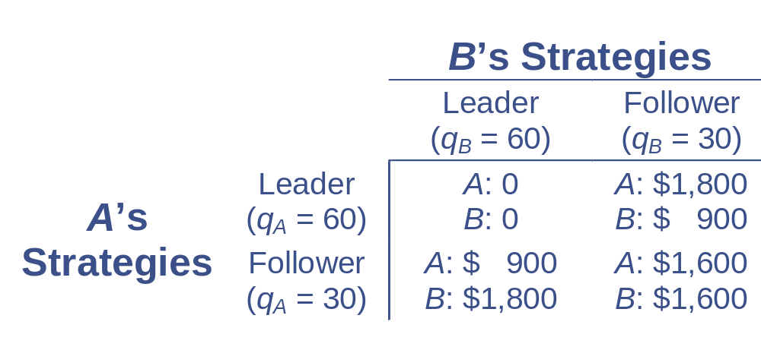
First-Mover Advantage in Cournot’s Natural Springs
The payoffs for these two strategies are:

Slide 78
First-Mover Advantage in Cournot’s Natural Springs
The leader-leader strategy for each firm proves to be disastrous
  it is not a Nash equilibrium
    if firm A knows that firm B will adopt a leader strategy, its best move is to be a follower
A follower-follower choice is profitable for both firms
  this choice is unstable because it gives each firm an incentive to cheat

Slide 79
First-Mover Advantage in Cournot’s Natural Springs
With simultaneous moves, either of the leader-follower pairs represents a Nash equilibrium
But if one firm has the opportunity to move first, it can dictate which of the two equilibria is chosen
  this is the first-mover advantage

Slide 80
Entry Deterrence
In some cases, first-mover advantages may be large enough to deter all entry by rivals
  however, it may not always be in the firm’s best interest to create that large a capacity

Slide 81
Entry Deterrence
With economies of scale, the possibility for profitable entry deterrence is increased
  if the first mover can adopt a large-enough scale of operation, it may be able to limit the scale of a potential entrant
    the potential entrant will experience such high average costs that there would be no advantage to entering the market

Slide 82
Entry Deterrence in Cournot’s Natural Spring
Assume that each spring owner must pay a fixed cost of operations ($784)
The Nash equilibrium leader-follower strategies remain profitable for both firms
  if firm A moves first and adopts the leader’s role, B’s profits are relatively small ($116)
    A could push B out of the market by being a bit more aggressive

Slide 83
Entry Deterrence in Cournot’s Natural Spring
Since B’s reaction function is unaffected by the fixed costs, firm A knows that
q_{B} = (120 - q_{A})/2
and market price is given by
P = 120 - q_{A} - q_{B}
Firm A knows that B’s profits are
π_{B} = Pq_{B} - 784

Slide 84
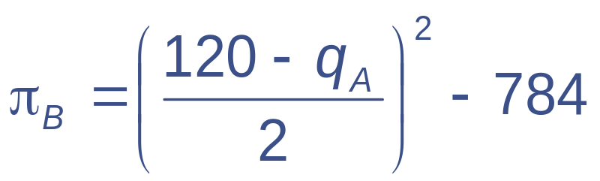
Entry Deterrence in Cournot’s Natural Spring
When B is a follower, its profits depend only on q_{A}
Therefore,
Firm A can ensure nonpositive profits for firm B by choosing q_{A} ≥ 64
  Firm A will earn profits of $2,800

Slide 85
Limit Pricing
Are there situations where a monopoly might purposely choose a low (“limit”) price policy to deter entry into its market?
In most simple situations, the limit pricing strategy does not yield maximum profits and is not sustainable over time
  choosing P_{L} < P_{M} will only deter entry if P_{L} is lower than the AC of any potential entrant

Slide 86
Limit Pricing
If the monopoly and the potential entrant have the same costs, the only limit price sustainable is P_{L} = AC
  defeats the purpose of being a monopoly because π = 0
Thus, the basic monopoly model offers little room for entry deterrence through pricing behavior

Slide 87
Limit Pricing and Incomplete Information
Believable models of limit pricing must depart from traditional assumptions
The most important set of such models involves incomplete information
  if an incumbent monopolist knows more about the market situation than a potential entrant, the monopolist may be able to deter entry

Slide 88
Limit Pricing and Incomplete Information
Suppose that an incumbent monopolist may have either “high” or “low” production costs as a result of past decisions
The profitability of firm B’s entry into the market depends on A’s costs
We can use a tree diagram to show B’s dilemma

Slide 89
Limit Pricing and Incomplete Information
1,3
The profitability of entry for Firm B depends on Firm A’s costs which are unknown to B
Entry
B
•
High Cost
No Entry
4,0
A
•
3,-1
Entry
Low Cost
B
•
No Entry
6,0

Slide 90
Limit Pricing and Incomplete Information
Firm B could use whatever information it has to develop a subjective probability of A’s cost structure
If B assumes that there is a probability of ρ that A has high cost and (1-ρ) that it has low cost, entry will yield positive expected profits if
E(π_{B}) = ρ(3) + (1-ρ)(-1) > 0
ρ > ¼

Slide 91
Limit Pricing and Incomplete Information
Regardless of its true costs, firm A is better off if B does not enter
One way to ensure this is for A to convince B that ρ < ¼
Firm A may choose a low-price strategy then to signal firm B that its costs are low
  this provides a possible rationale for limit pricing

Slide 92
Predatory Pricing
The structure of many models of predatory behavior is similar to that used in limit pricing models
  stress incomplete information
A firm wishes to encourage its rival to exit the market
  it takes actions to affect its rival’s views of the future profitability of remaining in the market

Slide 93
Games of Incomplete Information
Each player in a game may be one of a number of possible types (t_{A} and t_{B})
  player types can vary along several dimensions
We will assume that our player types have differing potential payoff functions
  each player knows his own payoff but does not know his opponent’s payoff with certainty

Slide 94
Games of Incomplete Information
Each player’s conjectures about the opponent’s player type are represented by belief functions [f_{A}(t_{B})]
  consist of the player’s probability estimates of the likelihood that his opponent is of various types
Games of incomplete information are sometimes referred to as Bayesian games

Slide 95
Games of Incomplete Information
We can now generalize the notation for the game
G[S_{A},S_{B},t_{A},t_{B},f_{A},f_{B},U_{A}(a,b,t_{A},t_{B}),U_{B}(a,b,t_{A},t_{B})]
The payoffs to A and B depend on the strategies chosen (a ⊂ S_{A}, b ⊂ S_{B}) and the player types

Slide 96
Games of Incomplete Information
For one-period games, it is fairly easy to generalize the Nash equilibrium concept to reflect incomplete information
  we must use expected utility because each player’s payoffs depend on the unknown player type of the opponent

Slide 97
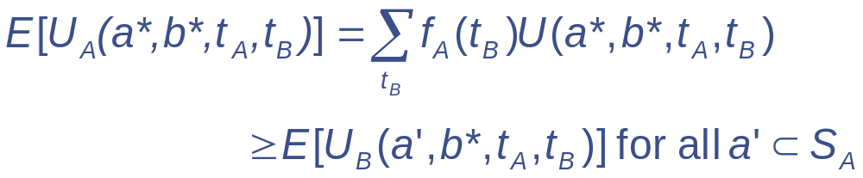
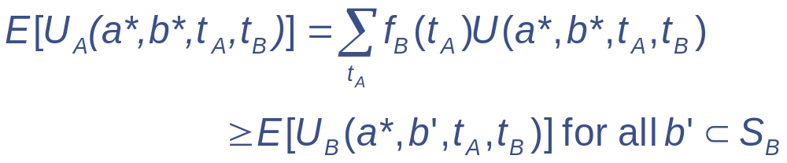
Games of Incomplete Information
A strategy pair (a*,b*) will be a Bayesian-Nash equilibrium if a* maximizes A’s expected utility when B plays b* and vice versa

Slide 98
A Bayesian-Cournot Equilibrium
Suppose duopolists compete in a market for which demand is given by
P = 100 – q_{A} – q_{B}
Suppose that MC_{A} = MC_{B} = 10
  the Nash (Cournot) equilibrium is q_{A} = q_{B} = 30 and payoffs are π_{A} = π_{B} = 900

Slide 99
A Bayesian-Cournot Equilibrium
Suppose that MC_{A} = 10, but MC_{B} may be either high (= 16) or low (= 4)
Suppose that A assigns equal probabilities to these two “types” for B so that the expected MC_{B} = 10
B does not have to consider expectations because it knows there is only a single A type

Slide 100
A Bayesian-Cournot Equilibrium
B chooses q_{B} to maximize
π_{B} = (P – MC_{B})(q_{B}) = (100 – MC_{B} – q_{A} – q_{B})(q_{B})
The first-order condition for a maximum is
q_{B}* = (100 – MC_{B} – q_{A})/2
Depending on MC_{B}, this is either
q_{B}* = (84 – q_{A})/2 or
q_{B}* = (96 – q_{A})/2

Slide 101
A Bayesian-Cournot Equilibrium
Firm A must take into account that B could face either high or low marginal costs so its expected profit is
π_{A} = 0.5(100 – MC_{A} – q_{A} – q_{BH})(q_{A}) + 0.5(100 – MC_{A} – q_{A} – q_{BL})(q_{A})
π_{A} = (90 – q_{A} – 0.5q_{BH} – 0.5q_{BL})(q_{A})

Slide 102
A Bayesian-Cournot Equilibrium
The first-order condition for a maximum is
q_{A}* = (90 – 0.5q_{BH} – 0.5q_{BL})/2
The Bayesian-Nash equilibrium is:
q_{A}* = 30
q_{BH}* = 27
q_{BL}* = 33
These choices represent an ex ante equilibrium

Slide 103
Mechanism Design and Auctions
The concept of Bayesian-Nash equilibrium has been used to study auctions
  by examining equilibrium solutions under various possible auction rules, game theorists have devised procedures that obtain desirable results
    achieving high prices for the goods being sold
    ensuring the goods end up with those who value them most

Slide 104
An Oil Tract Auction
Suppose two firms are bidding on a tract of land that may have oil underground
Each firm has decided on a potential value for the tract (V_{A} and V_{B})
The seller would like to obtain the largest price possible for the land
  the larger of V_{A} or V_{B}
Will a simple sealed bid auction work?

Slide 105
An Oil Tract Auction
To model this as a Bayesian game, we need to model each firm’s beliefs about the other’s valuations
  0 ≤ V_{i} ≤ 1
  each firm assumes that all possible values for the other firm’s valuation are equally likely
    firm A believes that V_{B} is uniformly distributed over the interval [0,1] and vice versa

Slide 106
An Oil Tract Auction
Each firm must now decide its bid (b_{A} and b_{B})
The gain from the auction for firm A is
V_{A} - b_{A} if b_{A} > b_{B}
and
0 if b_{A} < b_{B}
Assume that each player opts to bid a fraction (k_{i}) of the valuation

Slide 107
An Oil Tract Auction
Firm A’s expected gain from the sale is
π_{A} = (V_{A} - b_{A}) ⋅ Prob(b_{A} > b_{B})
Since A believes that V_{B} is distributed normally,
prob(b_{A} > b_{B}) = prob(b_{A} > k_{B}V_{B}) = prob(b_{A} /k_{B} > V_{B}) = b_{A} /k_{B}
Therefore,
π_{A} = (V_{A} - b_{A})⋅ (b_{A} /k_{B})

Slide 108
An Oil Tract Auction
Note that π_{A} is maximized when
b_{A} = V_{A} /2
Similarly,
b_{B} = V_{B} /2
The firm with the highest valuation will win the bid and pay a price that is only 50 percent of the valuation

Slide 109
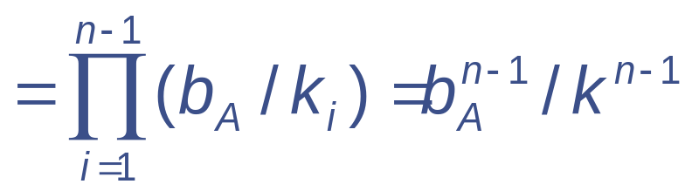
An Oil Tract Auction
The presence of additional bidders improves the situation for the seller
If firm A continues to believe that each of its rivals’ valutions are uniformly distributed over the [0,1] interval,
prob(b_{A} > b_{i}) = prob(b_{A} > k_{i}V_{i}) for i = 1,…,n

Slide 110
An Oil Tract Auction
This means that
π_{A} = (V_{A} - b_{A})(b_{A}^{n -1}/k^{n -1})
and the first-order condition for a maximum is
b_{A} = [(n-1)/n]V_{A}
As the number of bidders rises, there are increasing incentives for a truthful revelation of each firm’s valuation

Slide 111
Dynamic Games with Incomplete Information
In multiperiod and repeated games, it is necessary for players to update beliefs by incorporating new information provided by each round of play
Each player is aware that his opponent will be doing such updating
  must take this into account when deciding on a strategy

Slide 112
Important Points to Note:
All games are characterized by similar structures involving players, strategies available, and payoffs obtained through their play
  the Nash equilibrium concept provides an attractive solution to a game
    each player’s strategy choice is optimal given the choices made by the other players
    not all games have unique Nash equilibria

Slide 113
Important Points to Note:
Two-person noncooperative games with continuous strategy sets will usually possess Nash equilibria
  games with finite strategy sets will also have Nash equilibria in mixed strategies

Slide 114
Important Points to Note:
In repeated games, Nash equilibria that involve only credible threats are called subgame-perfect equilibria

Slide 115
Important Points to Note:
In a simple single-period game, the Nash-Bertrand equilibrium implies competitive pricing with price equal to marginal cost
The Cournot equilibrium (with p > mc) can be interpreted as a two-stage game in which firms first select a capacity constraint

Slide 116
Important Points to Note:
Tacit collusion is a possible subgame- perfect equilibrium in an infinitely repeated game
  the likelihood of such equilibrium collusion diminishes with larger numbers of firms, because the incentive to chisel on price increases

Slide 117
Important Points to Note:
Some games offer first-mover advantages
  in cases involving increasing returns to scale, such advantages may result in the deterrence of all entry

Slide 118
Important Points to Note:
Games of incomplete information arise when players do not know their opponents’ payoff functions and must make some conjectures about them
  in such Bayesian games, equilibrium concepts involve straightforward generalizations of the Nash and subgame- perfect notions encountered in games of complete information

